Slide 1
PONV
Vanessa Moll, MD
Stanford Anesthesia

Slide 2
PONV
-the stats
Among most common side effects of anesthesia
Overall incidence of PONV for all surgeries and patient populations is estimated to be 25% to 30% (1)
0.18% risk of intractable PONV* -> delay in PACU discharge or unanticipated hospital admission -> increasing medical costs (2)
Reduces patient satisfaction
* intractable PONV: no unified textbook definition for intractable PONV.
It ranges from N/V > 4h to repeated, severe episodes of PONV within 48 h presenting on at least three different occasions associated with the use of general anesthesia with volatile anesthetics and opioids (with or without prior use of different antiemetic).
Vanessa Moll, MD
Stanford Anesthesia

Slide 3
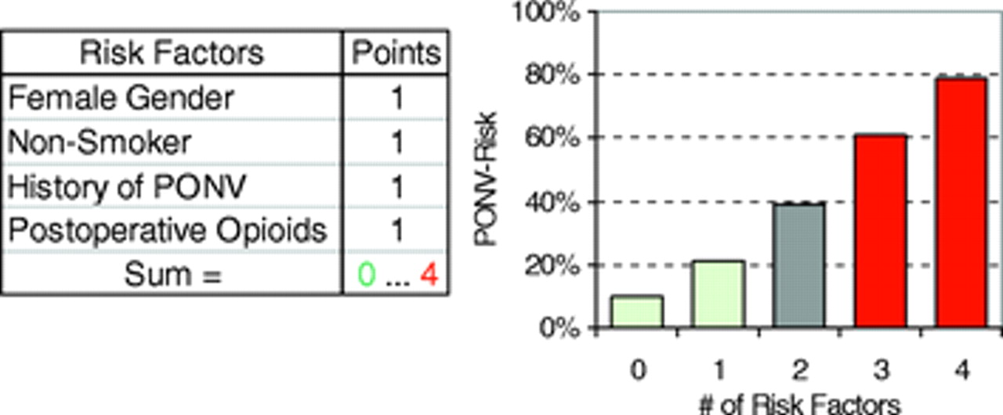
PONV
-the simplified Apfel score (3)
The use of postop opioids in this score system is questionable. Use of opioids intra- and postop adds to the risk of PONV. Interesting study.
Vanessa Moll, MD
Stanford Anesthesia
Notes:
HPI per sister and EMS

Slide 4
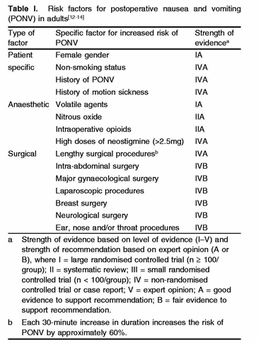
PONV
-more risk stratifications (30)
Speculations form papers why breast sx or gynecological sx increases risk of PONV are: female gender, mostly non-smokers, age, hormone status and psychological factors
Vanessa Moll, MD
Stanford Anesthesia
Notes:
HPI per sister and EMS

Slide 5
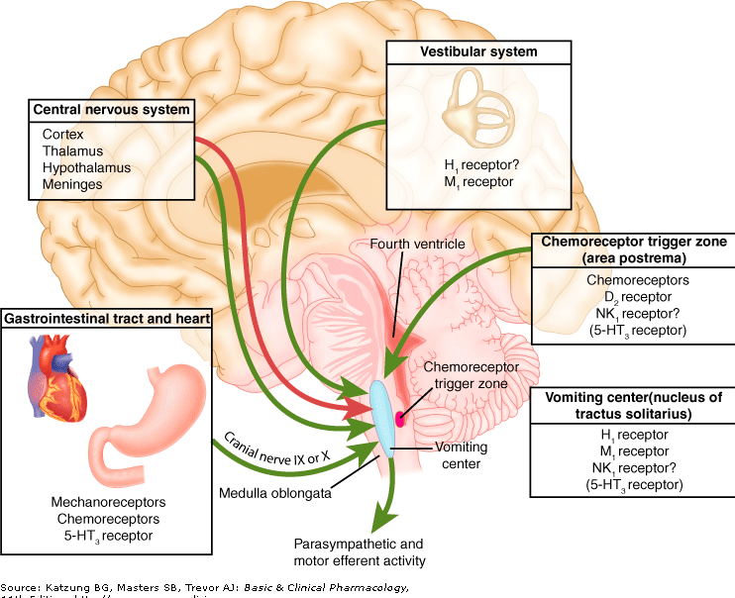
PONV
-mechanism
Please see following slides with medications that act on receptors seen on this slide.
For a more detailed review go to reference 30.
Vanessa Moll, MD
Stanford Anesthesia

Slide 6
PONV
-what we have
Dopamine (D₂) receptor antagonists: phenothiazines (e.g., promethazine, prochlorperazine), butyrophenones (e.g., droperidol, haloperidol), benzamides (e.g., metoclopramide)
Antihistamines (e.g., dimenhydrinate, cyclizine)
Anticholinergics (e.g., scopolamine)
Serotonin receptor antagonists (e.g., ondansetron, dolasetron, granisetron)
Neurokinin-1 receptor antagonists (e.g., Aprepitant)
Vanessa Moll, MD
Stanford Anesthesia

Slide 7
PONV
-what we have
Steroids- mostly dexamethasone
Propofol- used as TIVA (reduction of PONV), as subhypnotic infusions accompanying balanced anaesthesia (conflicting results) and as rescue for PONV in PACU or in chemotherapy induced N/V settings.
Benzodiazepines (4,5)
Ephedrine (6)- used in few studies at end of surgery
Aggressive intravenous hydration (8)- no textbook definition on how much hydration is aggressive. Most studies in outpatient surgery and have drawn conflicting conclusions.
Accupuncture*, accupressure*, TENS, hypnosis
* done at LPCH
Vanessa Moll, MD
Stanford Anesthesia

Slide 8
PONV
-medications
At least five major receptor systems involved in the etiology of PONV: dopaminergic (D₂), cholinergic (muscarinic), histaminergic (H₁), serotonergic (5-HT₃), and the neurokinin-1 (NK-1) receptors (see slide 5)
Metoclopramide
has prokinetic effects, its antiemetic efficacy is uncertain, with approximately 50% of studies showing it to be no more effective than placebo when used in a dose of 10 mg (9). Two recent studies, however, suggested that higher doses of metoclopramide (20 to 50 mg) given at the end of surgery might be efficacious ( 10, 11).
Vanessa Moll, MD
Stanford Anesthesia

Slide 9
PONV
-medications
5-HT-Antagonists
Highly specific and selective for nausea and vomiting
Antivomiting efficacy is better than their antinausea efficacy (12)
Binding to the 5-HT₃ receptor in the chemoreceptor trigger zone and at vagal afferents in the gastrointestinal tract.
Lack of sedation (Great for ambulatory surgery!)
Ondansetron, granisetron, and dolasetron. (no evidence that there is any difference in efficacy or side-effect profile between the various 5-HT₃ receptor antagonists)
Higher doses used in chemotherapy induced N/V but in PONV dose-effect studies have shown no additional benefit >8mg but increase in side effects (headache, dizziness, constipation)
Vanessa Moll, MD
Stanford Anesthesia

Slide 10
PONV
-medications
Glucocorticoids
Decrease the production of inflammatory mediators which are known to act on the CTZ area, improve the blood-brain barrier function
Methylprednisone and dexamethasone antagonize 5-HT_{3A} receptors expressed in Xenopus oocytes. Thus, antagonism of 5-HT receptors may contribute to the prophylactic effects of corticosteroids. (28)
Bethamethasone has been used in chemotherapy related studies and PONV studies with conflicting results, methylprednisone is used in chemotherapy related N/V
An animal study (ferrets) using a cisplatin induced emesis model describes the antiemetic potency of steroids as follows Bethamethasone>Dexamethasone>Methylprednisone>Hydrocortisone (26)
Vanessa Moll, MD
Stanford Anesthesia

Slide 11
PONV
-medications
Dexamethasone (DX)
Most PONV studies done with single dose DX, other glucocorticoids (GC) might work also. A nice review paper about GC is (27).
DX reported to be especially effective against late PONV (8 or 10 mg IV in adults), with no dexamethasone-related side effects when used as a single dose for PONV prophylaxis (13) with 4mg also being effective (14)
Multicenter IMPACT study recruited over 5000 patient with a PONV score of at least 40% according to the simplified Apfel score. In this factorial design study single dose use of either ondansetron 4 mg, droperidol 1.25 mg, and dexamethasone 4mg lead to a similar reduction in PONV (14)
Vanessa Moll, MD
Stanford Anesthesia

Slide 12
PONV
-medications
Scopolamine
Anticholinergic agent.
Transdermal patch, slow delivery system, maximum effect in 3-4 hours, lasts for 72 (slow onset may limit use in every day practice)
Dry mouth, double vision, and especially in the elderly, dizziness and in some rare cases agitation
Transdermal scopolamine effective in controlling PONV following outpatient laparoscopy (15) and following neuraxial* morphine administration (16, 17)
*use of neuraxial opioids can cause PONV in up to 30% of patients (24,25)
Vanessa Moll, MD
Stanford Anesthesia

Slide 13
PONV
-medications
Neurokinin-1 receptor antagonists
New class of antiemetics that may act on the final common pathway from the emetic center.
Recent multicenter study compared PO aprepitant with IV ondansetron (4mg) in females undergoing abdominal surgery. The incidence of no vomiting (0 to 24 hours) was significantly higher with aprepitant 40 mg (84%) and aprepitant 125 mg (86%) versus ondansetron (71%). Aprepitant reduced the nausea severity according to a verbal rating score but incidence and severity or need for rescue antiemetics were not different across the three groups (18) This was reproduced in another large study which also showed a lower nausea severity (19)
The 40-mg dose of aprepitant was approved for the prophylaxis of PONV. (40mg equally effective as 125mg)
Vanessa Moll, MD
Stanford Anesthesia

Slide 14
PONV
-medications
Antihistamines
Ethanolamines (dimenhydrinate, diphenhydramine) and the piperazines (cyclizine, hydroxyzine, meclizine).
Major disadvantages: sedation, dry mouth, blurred vision, urinary retention, and delayed recovery room discharge (20)
Promethazine is an effective antiemetic with a long duration of action.
In a dose of 12.5 to 25 mg given with induction, it is effective for PONV (21).
Its use is limited by sedation and prolonged recovery from anesthesia (9).
Vanessa Moll, MD
Stanford Anesthesia

Slide 15
PONV
-medications
Total intravenous anesthesia
TIVA using propofol as anesthetic maintenance has been shown to reduce the incidence of PONV and to be as efficacious as ondansetron 4 mg in reducing postoperative nausea (22, 23).
The protective effect of propofol against PONV was not evident when it was used as an induction agent only (24).
May be working through the serotonergic pathway
Complementary infusions of propofol in addition to gas based anesthesia have resulted in a mixed pictures of of effectiveness in papers. Some say it works as a PONV reduction (probably by gas sparing), some say it does not make a difference. One paper mentions the plasma levels of propofol need to be at least 343ng/ml to be effective in PONV reduction. (29)
Propofol is used as a rescue medication in PONV or
chemotherapy induced N/V
Vanessa Moll, MD
Stanford Anesthesia

Slide 16
PONV
-what to do
Screen patients for risk factors
Combining anti-emetics gives you an additive effect in risk reduction
Possibly avoid nitrous oxide or anesthetic gases
See next slide- Society for Ambulatory Anesthesia Guidelines for the Management of Postoperative Nausea and Vomiting
Vanessa Moll, MD
Stanford Anesthesia

Slide 17
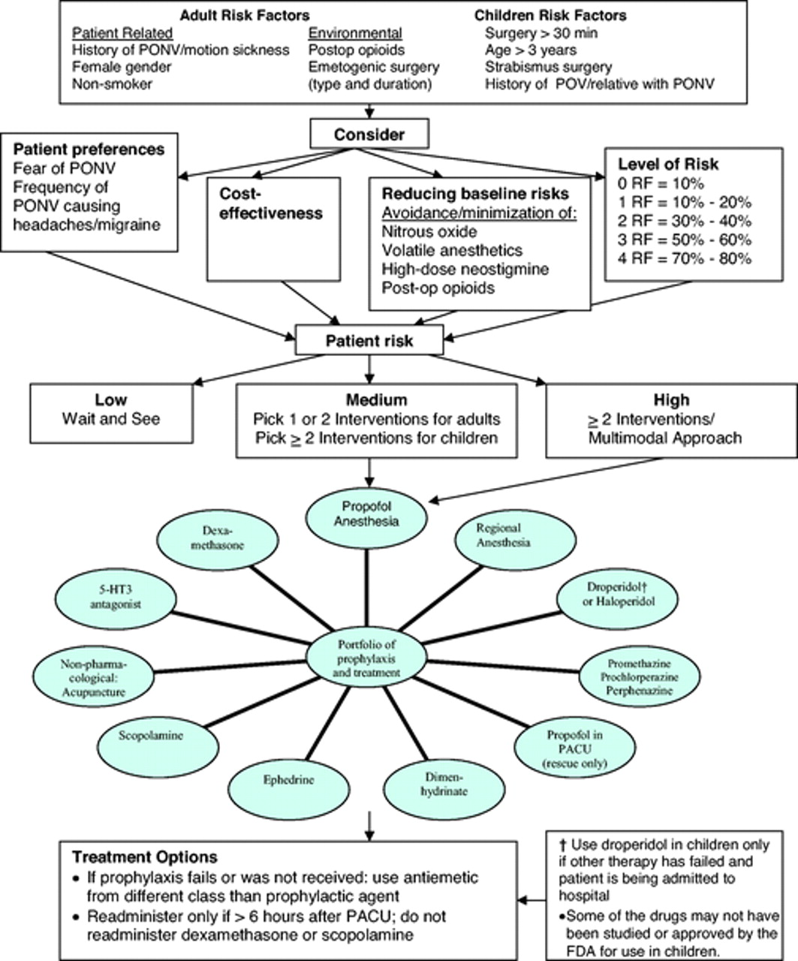
PONV
- What to do…
Algorithm for management of PONV
Society for Ambulatory Anesthesia Guidelines for the Management of Postoperative Nausea and Vomiting 2007 (31)
Vanessa Moll, MD
Stanford Anesthesia

Slide 18
PONV
- references
1. Kovac AL: Prevention and treatment of postoperative nausea and vomiting. Drugs 2000; 59:213-243.
2. Gold BS et al. Unanticipated admission to the hospital following ambulatory surgery. JAMA 1989; 262:3008-3010.
3. Apfel CC et al. A simplified risk score for predicting postoperative nausea and vomiting. Anesthesiology 1999;91:693–700
4. Splinter WM,et al. Midazolam reduces vomiting after tonsillectomy in children. Can J Anaesth 1995; 42:201-203.
5. Khalil SN et al. The antiemetic effect of lorazepam after outpatient strabismus surgery in children. Anesthesiology 1992; 77:915-919.
6. Rothenberg DM et al. Efficacy of ephedrine in the prevention of postoperative nausea and vomiting. Anesth Analg 1991; 72:58-61.
8. Yogendran S et al. A prospective randomized double-blinded study of the effect of intravenous fluid therapy on adverse outcomes on outpatient surgery. Anesth Analg 1995; 80:682-686.
9. Rowbotham DJ: Current management of postoperative nausea and vomiting. Br J Anaesth 1992; 69:46S-59S.
Vanessa Moll, MD
Stanford Anesthesia
Notes:
Only pertinent lab finding positive (+) THC.
Consulted Poison Control Center - San Francisco Division, no additional recs

Slide 19
PONV
- references
10. Quaynor H, Raeder JC: Incidence and severity of postoperative nausea and vomiting are similar after metoclopramide 20 mg and ondansetron 8 mg given by the end of laparoscopic cholecystectomies. Acta Anaesthesiol Scand 2002; 46:109-113.
11. Wallenborn J, et al: Prevention of postoperative nausea and vomiting by metoclopramide combined with dexamethasone: Randomised double blind multicentre trial. BMJ 2006; 333:324.
12. Tramer MR, et al. Efficacy, dose-response, and safety of ondansetron in prevention of postoperative nausea and vomiting: A quantitative systematic review of randomized placebo-controlled trials. Anesthesiology 1997; 87:1277-1289.
13. Henzi I, et al: Dexamethasone for the prevention of postoperative nausea and vomiting: A quantitative systematic review. Anesth Analg 2000; 90:186-194.
14. Apfel CC, et al: A factorial trial of six interventions for the prevention of postoperative nausea and vomiting. N Engl J Med 2004; 350:2441-2451.
15. Bailey PL, et al. Transdermal scopolamine reduces nausea and vomiting after outpatient laparoscopy. Anesthesiology 1990; 72:977-980.
16. Loper KA, et al. Prophylactic transdermal scopolamine patches reduce nausea in postoperative patients receiving epidural morphine. Anesth Analg 1989; 68:144-146.
17. Harnett MJ, et al. Transdermal scopolamine for prevention of intrathecal morphine-induced nausea and vomiting after cesarean delivery. Anesth Analg 2007; 105:764-769.
Vanessa Moll, MD
Stanford Anesthesia
Notes:
Only pertinent lab finding positive (+) THC.
Consulted Poison Control Center - San Francisco Division, no additional recs

Slide 20
PONV
- references
18. Gan TJ, et al. A randomized, double-blind comparison of the NK1 antagonist, aprepitant, versus ondansetron for the prevention of postoperative nausea and vomiting. Anesth Analg 2007; 104:1082-1089.
19. Diemunsch P, et al. Single-dose aprepitant vs ondansetron for the prevention of postoperative nausea and vomiting: A randomized, double-blind phase III trial in patients undergoing open abdominal surgery. Br J Anaesth 2007; 99:202-211.
20. Dundee JW, et al. A comparison of the efficacy of cyclizine and perhenazine in reducing the emetic effects of morphine and pethidine. Br J Clin Pharmacol 1975; 2:81-85.
21. Khalil S, et al. Ondansetron/promethazine combination or promethazine alone reduces nausea and vomiting after middle ear surgery. J Clin Anesth 1999; 11:596-600.
22. Tramer M, Moore A, McQuay H: Meta-analytic comparison of prophylactic antiemetic efficacy for postoperative nausea and vomiting: Propofol anaesthesia vs omitting nitrous oxide vs total I.V. anaesthesia with propofol. Br J Anaesth 1997; 78:256-259.
23. Gan TJ, et al.Double-blind, randomized comparison of ondansetron and intraoperative propofol to prevent postoperative nausea and vomiting. Anesthesiology 1996; 85:1036-1042.
24. Tramer M, Moore A, McQuay H: Propofol anaesthesia and postoperative nausea and vomiting: Quantitative systematic review of randomized controlled studies. Br J Anaesth 1997; 78:247-255.
Vanessa Moll, MD
Stanford Anesthesia
Notes:
Only pertinent lab finding positive (+) THC.
Consulted Poison Control Center - San Francisco Division, no additional recs

Slide 21
PONV
- references
24. Bromage PR, Camporesi EM, Durant PAC, Nielsen CH. Nonrespiratory side effects o f epidural morphine A and A, 1982
25. Chaney, MA Intrathecal and Epidural Anesthesia and Analgesia for Cardiac Surgery. Anesth Analg January 2006 102:45-64
26. Tasia S.W Sam, Shun W Chan, John A Rudd, John H.K Yeung, Action of glucocorticoids to antagonise cisplatin-induced acute and delayed emesis in the ferret, European Journal of Pharmacology, 2001, 231-237,
27. Kathrine Holte, Henrik Kehlet, Perioperative single-dose glucocorticoid administration: pathophysiologic effects and clinical implications, Journal of the American College of Surgeons, 2002,195:5-694-712
28. Suzuki T, Sugimoto M, Koyama H, et al Inhibitory effect of glucocorticoids on human-cloned 5-hydroxytryptamine_{3A} receptor expressed in Xenopus oocytes. Anesthesiology 2004;101:660-665.
29. Gan TJ, Glass PS, Howell ST et al. Determination of plasma concentration of propofol associated with 50% reduction in postoperative nausea. Anesthesiology 1997; 87: 779–784.
30.Gan,TJ.Mechanisms underlying postoperative nausea and vomiting and neurotransmitter receptor antagonist-based pharmacotherapy. CNS Drugs. 2007;21(10):813-33.
31. Gan TJ et al. Society for Ambulatory Anesthesia Guidelines for the Management of Postoperative Nausea and Vomiting. Anesth Analg 2007;105:1615-1628
Vanessa Moll, MD
Stanford Anesthesia
Notes:
Only pertinent lab finding positive (+) THC.
Consulted Poison Control Center - San Francisco Division, no additional recs

