Slide 1
Liver Resection
Abdominal Surgery Curriculum
Jen Basarab-Tung

Slide 2
Background
Indications:
  Primary tumors
    Hepatocellular carcinoma
    Cholangiocarcinoma
  Metastatic tumors
    Colorectal cancer
    Neuroendocrine tumors
  Benign disease
    Symptomatic giant hemangioma
    Hepatic adenoma (risk of rupture and malignant degeneration)
  Living donors for liver transplants
    Most commonly left lateral for pediatric recipient
    R hepatectomy for adult-adult in some centers

Slide 3
Background
Indication for resection may inform you about condition of underlying liver
  HCC almost exclusively arises in setting of cirrhosis
  CholangioCa often associated with cholestasis
Resectability
  Determined by CT or MRI
  Function of location, underlying parenchyma, and future remnant size → Will the patient have enough functional liver left to survive?

Slide 4
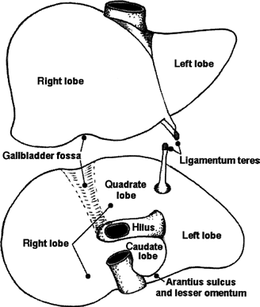
Relevant Anatomy
Liver gets 25% of cardiac output
Blood flow from the portal vein (75%) and hepatic artery (25%)
Post-hepatectomy survival requires only 30% of functional liver remaining
Liver can be divided into 4 lobes based on surface anatomy:
  Right
  Left
  Caudate
  Quadrate
But liver resections refer to a more complicated system of classification

Slide 5
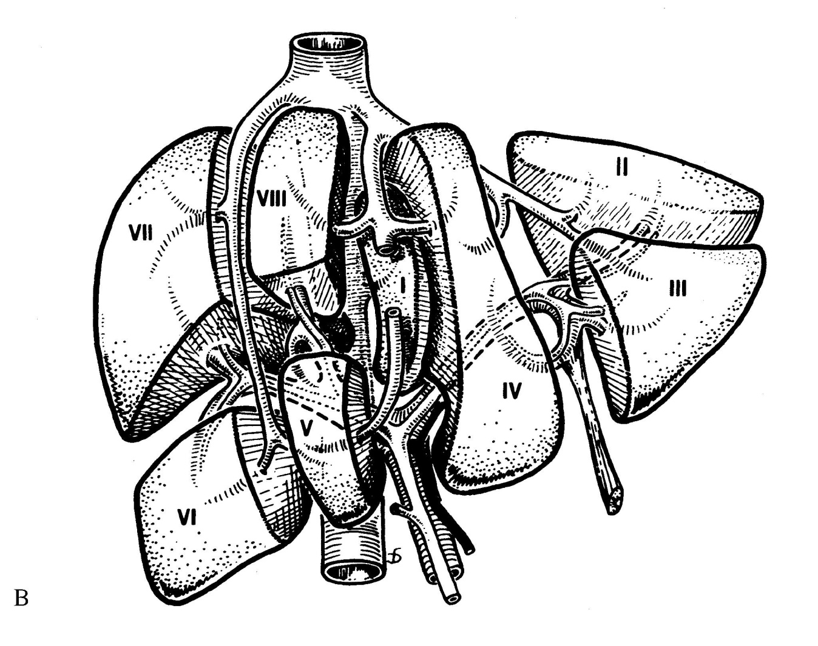
Relevant Anatomy
The Couinaud classification divides liver into 8 segments, each with its own vascular supply and biliary drainage:
Note the clockwise numbering
No surface markers
Caudate: 1
Left liver: 2, 3, 4
Right liver: 5, 6, 7, 8
Ligamentum Teres

Slide 6
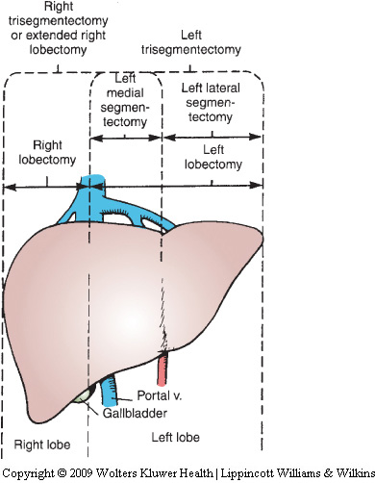
Relevant Anatomy
or right lobectomy
Major hepatectomy: resection of 3 or more segments
  Right hepatectomy: 5, 6, 7, 8
  Right lobectomy or trisegmentectomy: 4, 5, 6, 7, 8
  Left lobectomy: 2, 3, 4
  Left trisegmentectomy: 2, 3, 4, 5, 8
Non-anatomic resection (wedge resection or segmentectomy) possible for small tumors
Segment 1 has its own (variable) blood supply and can be resected with any other lobes/segments
Right
hepatectomy
8 2
4 3
6 5

Slide 7

Preoperative Considerations
Liver function
  Synthetic funtion (Tbili, albumin, coags)
  Transaminases
    If elevated in setting of viral hepatitis, may be marker of poorer regeneration post-hepatectomy
Correction of coagulopathy
  Vitamin K and/or FFP infrequently required for elective resections
Tumor markers: AFP (HCC), CA-19-9 (cholangio) and CEA (colon CA)
Assessment for resectability and metastasis (CT/MRI)

Slide 8
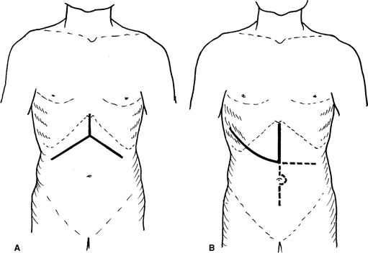
Incision
A: Bilateral subcostal incision, which may include excision of the xiphoid. B: J-shaped incision along 8th, 9th, or 10th intercostal space facilitates exposure of segment VII/VIII or tumor involving right diaphragm, and may be extended to the left or lower abdomen.

Slide 9
Anesthetic Considerations
Consider epidural for post-op pain control
  Check coags/platelets and discuss w/ surgeon first
  Post-op coagulopathy related to extent of resection
Endotracheal intubation
  Use cisatracurium in cirrhotics
Carefully titrate hepatically cleared drugs to effect
Positioning is usually supine with arms tucked, so place lines early and make sure they run
Anticipate hemodynamic changes
  Cirrhotics often have low SVR with compensatory increase in CO at baseline
  Have vasoactive meds ready
Maintain normothermia
  Hypothermia can worsen coagulopathy

Slide 10
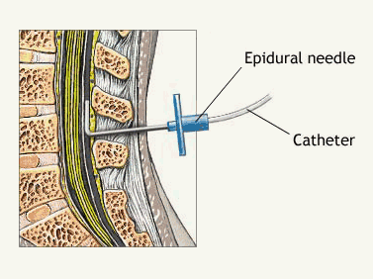
More on Epidurals
See syllabus for detailed info
Large upper abdominal incision
and high risk for post-up pulm
complications suggest epidural
analgesia would be helpful
At Stanford, epidurals for liver resections are controversial due to concern for post-op coagulopathy
  This is NOT the case at most other institutions
  As always, discuss plan for neuraxial anesthesia with your attending and the surgical team

Slide 11
Fluid and Blood Management
Anticipate significant blood loss in major resections
  300-500 ml in healthy livers, 400-800 ml in cirrhosis
  High risk of tearing vessels during mobilization of liver
  Unable to use cell salvage in cancer patients
T&C 2 units PRBC (95% of resections at Stanford use <2 units)
2 large-bore IVs and a-line almost universally
Consider central line and Level 1 or Belmont in room
  Cordis more useful than triple lumen when large losses are predicted
  Always consider risks/benefits and discuss with attending and surgeon; not all resections have large blood losses and require such measures
However, keep in mind that transfusion is associated with poor outcomes
  Infectious diseases, tumor recurrence, post-op mortality
  Try to avoid transfusion unless Hct <25

Slide 12
Low CVP Anesthesia
Low CVP (<5) is strongly associated with decreased blood loss and better outcomes in experienced centers
  Almost all bleeding in liver resection is from hepatic veins
Not all resections require a central line
  Usually surgical team will help guide your decision as they will anticipate whether low CVP anesthesia will be helpful
See section on invasive monitors for a critical discussion of CVP

Slide 13
Complications
Major resections may require ICU care
Mortality should be <2-5% in experienced hands
Virtually all patients have some respiratory complication
  Atelectasis, effusion, pneumonia
Ascites occurs in 20-30% of patients
Liver failure
  Poor baseline hepatic function is a risk factor for worsening of liver failure post-operatively
  Elderly people are at higher risk due to smaller livers and fatty replacement
  Early signs include hypotension, pressor requirement, and metabolic acidosis toward the end of the case

Slide 14

Special Considerations
Pringle maneuver
  Occluding contents of hepaticoduodenal ligament (portal vein, hepatic artery, and common bile duct) to minimize blood loss
  Used during transection of liver parenchyma
  Keep track of “Pringle time” similarly to tourniquet time and notify surgeons q5 min
  Clamp for 15 min, unclamp for 5 min, repeat
    Up to 120 min total ischemia time
    Consider 10 min clamp, 5 min unclamp in cirrhotics
Sometimes the inflow and outflow tracts are both occluded (total vascular occlusion)
  60-90 minutes usually minutes usually tolerated, though not well and thus performed infrequently

Slide 15
Board Review Questions
Which of the following statements regarding the anesthetic management of the patient with advanced liver disease is TRUE?
  A. Physical examination of the patient with chronic liver disease is not valuable because patients do not appear ill before laboratory evidence of hepatic dysfunction.
  B. Increased magnitude of liver dysfunction does not correlate with higher morbidity and mortality.
  C. Drugs administered to patients with advanced hepatic disease require careful titration against effect.
  D. Decreased doses of vasoconstrictors are needed in these patients.

Slide 16
Board Review Questions
Answer: C.
  Physical examination of the patient is particularly valuable because patients may appear ill before there is laboratory evidence of hepatic dysfunction. If no suspicion of liver dysfunction arises, then routine laboratory testing for liver function is not necessary.
  Regardless of cause, increased magnitude of liver dysfunction correlates with a higher morbidity and mortality.
  Drugs administered to patients with advanced liver disease require careful titration. Encephalopathic changes are associate with clinically important alterations in pharmacodynamics and pharmacokinetics of various medications. Plasma clearance of fentanyl is significantly lower in cirrhotic patients.
  An increase in plasma concentrations of vasodilatory substances in cirrhotic patients results in reduced responses to catecholamines and other vasoconstrictors.

Slide 17
Board Review Questions
The liver receives its blood supply from:
  A. The hepatic artery only
  B. The portal vein only
  C. Both the hepatic artery and the portal vein
  D. Vessels that run in the center of the lobules
  E. The superior mesenteric artery

Slide 18
Board Review Questions
Answer: C
  The liver receives blood from the hepatic artery and the hepatic portal vein. The hepatic artery is a branch of the celiac trunk. The vessels, except for the central vein, run in the interlobular spaces.

Slide 19

Board Review Questions
In the patient with cirrhosis:
  A. The serum albumin level will be elevated
  B. Excessive sodium is lost in the urine
  C. Pancuronium is more effective
  D. Serum gamma globulin level will be low
  E. Less thiopental is required for induction

Slide 20
Board Review Questions
Answer: E
  Decreased plasma albumin levels decrease the bound fraction of thiopental and result in a greater fraction of free thiopental.
  Serum gamma globulin is higher in cirrhosis, and pancuronium has a larger volume of distribution; therefore, it is less effective for a given dose.
  Patients with cirrhosis excrete sodium-poor or sodium-free urine.

Slide 21
References
Special thanks to Dr. Visser for editing slides
Busque S et al. (2009). Liver/Kidney/Pancreas Transplantation. In Jaffe RA, Samuels SI (Eds.), Anesthesiologist’s Manual of Surgical Procedures (4th Ed., pp. 680-712). Philadelphia: Lippincott Williams and Wilkins.
Connelly NR and Silverman DG. (2006.) Review of Clinical Anesthesia, 4th ed. Philadelphia: Lippincott Williams & Wilkins.
Fan ST, Lo CM, and Liu CL. (2007). Major Hepatic Resection for Primary and Metastatic Tumors. In Fischer JE (Ed.), Mastery of Surgery (5th Ed., pp. 1076-1091). Philadelphia: Lippincott Williams and Wilkins.
Gozzetti G et al. Liver resection without blood transfusion. Br J Surg 1995;82,1105-1110
Khatri VP and Asensio JA. (2002.) Operative Surgery Manual. Philadelphia: Saunders Co.
So SKS, Oberhelman HA, and Lemmens HJM. (2009). Hepatic Surgery. In Jaffe RA, Samuels SI (Eds.), Anesthesiologist’s Manual of Surgical Procedures (4th Ed., pp. 550-567). Philadelphia: Lippincott Williams and Wilkins.

