Slide 1
Cholecystectomy
Abdominal Surgery Curriculum

Slide 2
Background
Cholecystectomy is performed most often laparoscopically for symptomatic gallstones (usually causing cholecystitis with fever, RUQ pain and leukocytosis), pancreatitis or acalculous cholecystitis

Slide 3
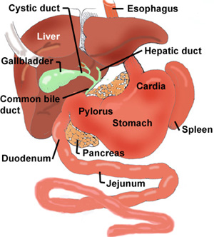
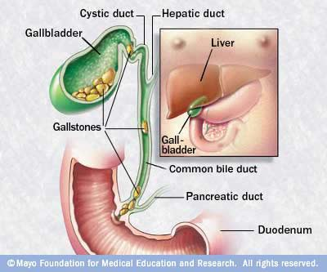
Relevant anatomy

Slide 4
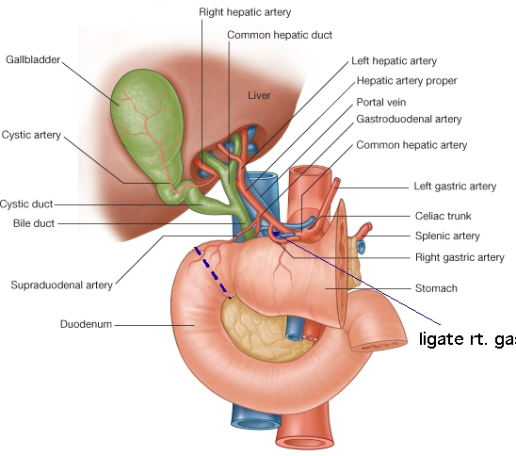
Relevant Anatomy II

Slide 5
Preoperative considerations
Patient population: the 4 F’s
Fat, female, forty, fertile
Airway exam is important!
Presenting symptoms include pain, nausea, vomiting therefore determine if RSI is indicated based on patient history
LFTs and RUQ ultrasound are typically done by surgeon prior to OR
If patient has acute cholecystitis
Assess respiratory status (pain ➔ splinting ➔ atelectasis ➔ hypoxia)
Assess hemodynamics (hypotensive, tachycardic? May warrant an a-line or 2nd PIV)

Slide 6
Procedure
After trocars are placed, the fundus of the GB is retracted caudally for exposure of the cystic duct and vessels
Cystic arteries (1 or 2) are clipped, cystic duct is clipped
The GB is carefully dissected from the liver bed from cystic duct up to fundus and removed
Intraoperative choleangiography
Cholangiography confirms the biliary anatomy and reveals the common bile duct (CBD) stones, allowing laparoscopic duct exploration if needed
Takes 10-15 mins, requires C-arm, some surgeons do it in every case, others perform it only if concerned about CBD stones

Slide 7
Induction and maintenance
Standard monitors and PIV
Unless septic which may warrant a-line or 2nd PIV
Before or after induction (standard vs. RSI based on history), decompress stomach with OGT
NMB improves surgical conditions for pneumoperitoneum but…
Entire case can take less than 30 minutes (especially at the Valley) therefore best goal is 1 out of 4 twitches
Avoid N₂O which may diffuse into abdominal space and increase distension

Slide 8
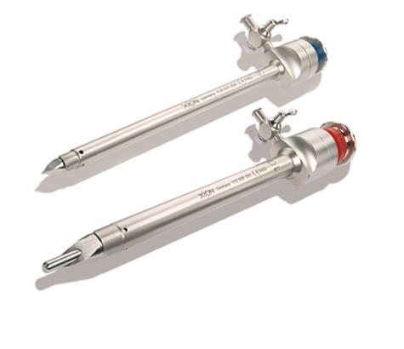
Special considerations
Trocar placement is DANGEROUS!!!
Blindly pushing a large, sharp object into the abdomen can lead to complications like trocar-in-iliac artery (which is BAD!)
Bleeding is the most common complication, often from cystic artery or right hepatic artery
Often will lead surgeons to convert to open procedure (~5% conversion rate) which will change management (no pneumoperitoneum, bigger incision)

Slide 9
Special considerations II
Lap choles are commonly day surgeries therefore PONV and pain control are major considerations
PONV (also see Subtopic 4D)
Most patients get ondansetron at the “end” of the case (time to peak is ~30 mins so for a short case consider giving it early!)
Meta-analysis of 17 trials showed that dexamethasone (4mg) at the start of the case may be beneficial (Karanicolas et al. 2008)
Pain
Multimodal therapy with NSAIDs (check renal function), local anesthetic wound infiltration and opioids provides best pain control

Slide 10
Board review questions
You are caring for a 26-year old female patient scheduled for a laparoscopic cholecystectomy. She reports a history of severe PONV. You are considering using aprepitant (Emend) as treatment. Which statement about aprepitant is MOST likely true?
It should be administered as close to the end of surgery as possible
Once administered, the patient can no longer receive ondansteron
It is thought to work by blocking the action substance P in the CNS
It is administered via the IV route
Modified from ACE program. Issue 7A.

Slide 11
Answer
C. It blocks the action of substance P via binding to the NK1 receptor
Dose of aprepitant 40mg PO should be given 1-3 hours prior to surgery
Completely inhibits PONV in 64% of patients (Gan TJ et al. A&A. 2007.)

Slide 12
Board review questions
An otherwise healthy 28 yo female is schedules to undergo laparoscopic cholecystectomy. A rapid sequence induction is performed but a copious quantity of nonoparticulate gastric contents is noted in the posterior pharynx on DL. Which of the following is MOST likely recommended in the management of this patient following tracheal intubation?
Tracheal suctioning
Steroid administration
Antibiotics
Bronchial lavage
Modified from ACE program. Issue 7B.

Slide 13
Answer
A. Tracheal suctioning
If regurgitation of gastric contents is recognized on DL, recommended immediate treatment includes placing the patient in a head-down position and suctioning the oropharynx prior to intubation.
Once the trachea is intubated most authors recommend tracheal suctioning, without lavage, to remove any residual fluid.
Gatric contents are generally sterile. There is no indication for steroids or antibiotics.

Slide 14
References
Curet MJ et al. (2009). Laparoscopic General Surgery. In Jaffe RA, Samuels SI (Eds.), Anesthesiologist’s Manual of Surgical Procedures (4th Ed., pp. 575-580). Philadelphia: Lippincott Williams and Wilkins.
Fielding GA. (2009). Laparoscopic cholecystectomy. In: Clavien PA, Sarr M, Fong Y, Georgiev P. (Eds.), Atlas of Upper Gastrointestinal and Hepato-Pancreato-Biliary Surgery (7th Ed., pp. 527-39). New York: Springer.
Karanicolas PJ et al. The impact of prophylactic dexamethasone on nausea and vomiting after laparoscopic cholecystectomy: a systematic review and meta-analysis. Ann Surg. 2008; 248 (5): 751-62.
Mitra S at al. Pain Relief in Laparoscopic Cholecystectomy-A Review of the Current Options. Pain Prac. 2011 Oct 19. Epub.

